Slide 1



UNIT 2; The world around me
Look back 3

Slide 2
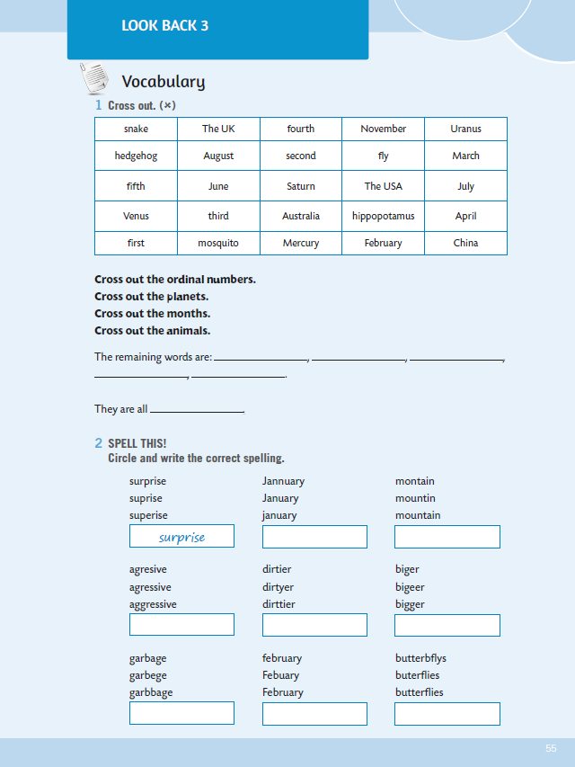
WB, page 56.
Prisjetimo se da smo ponovili i proširili vokabular vezan za redne brojeve, planete, mjesece i životinje… Naučili smo i stupnjevati pridjeve – dakle, njihove komparative i superlative. Osim toga ponovili smo i množinu imenica!

Slide 3

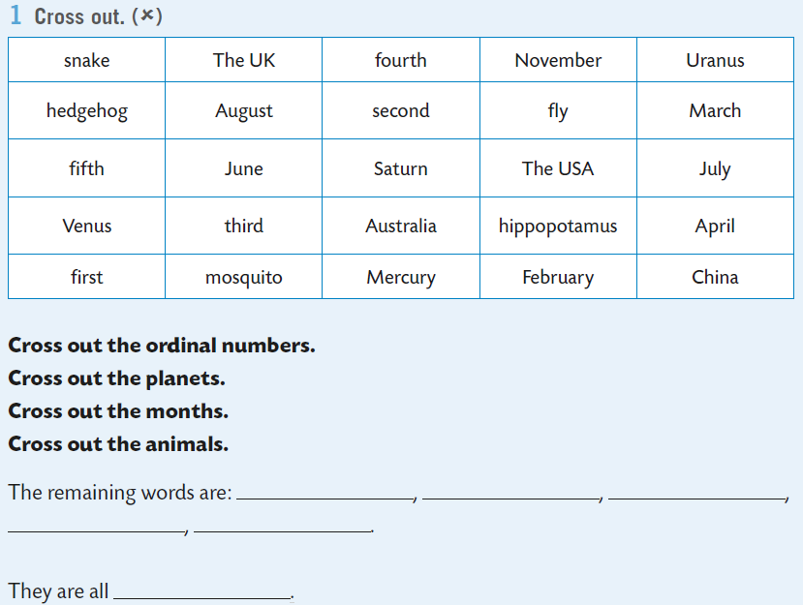
In task 1, you need to cross out the ordinal numbers, the planets, the months and the animals. Five words will not be crossed out. What category of words they belong to? U 1. zadatku moraš prekrižiti redne brojeve, planete, mjesece i životinje. Pet riječi ne pripadaju niti jednoj kategoriji. Koje su to riječi i kako bi ih ti nazvao jednom riječju?

Slide 4
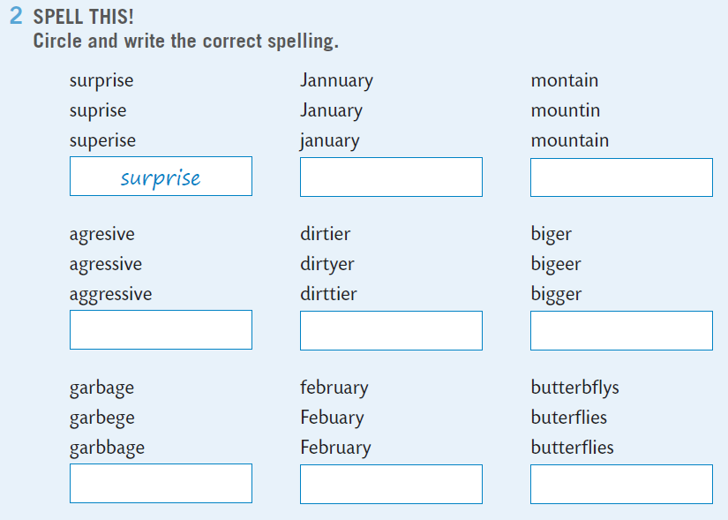

Next task deals with spelling. You have to circle and write the correct spelling.
January

Slide 5
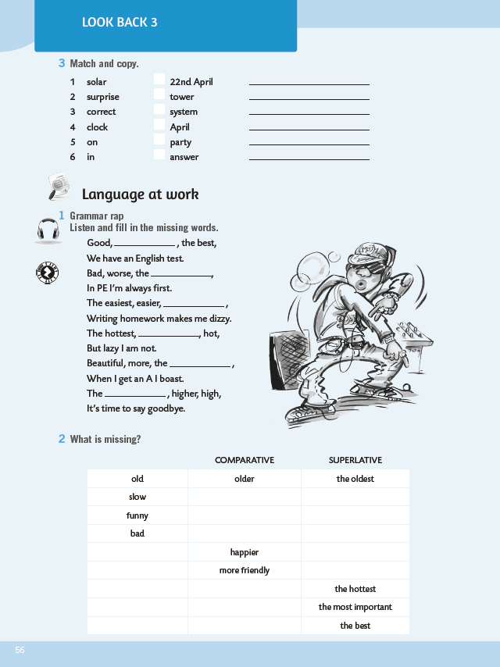
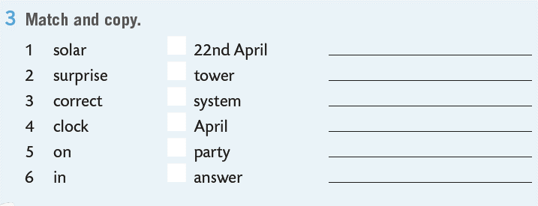
Match and copy the expressions in task 3.
solar system
1

Slide 6

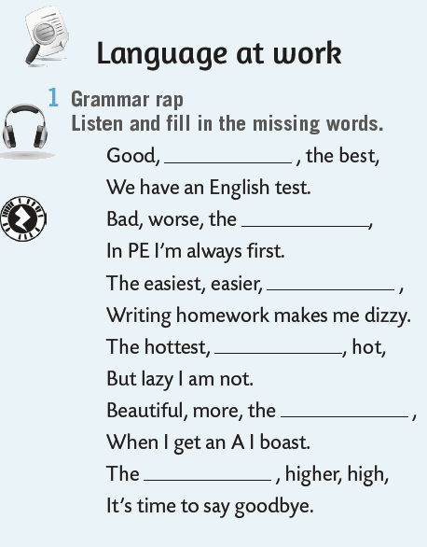

Fill in the missing words. Listen and check: https://www.e-sfera.hr/dodatni-digitalni-sadrzaji/09ab29d4-07dc-4f20-a706-763426686e76/assets/audio/look_back_3_-_grammar_rap.mp3
better
worst
easy
hotter
most
highest

Slide 7
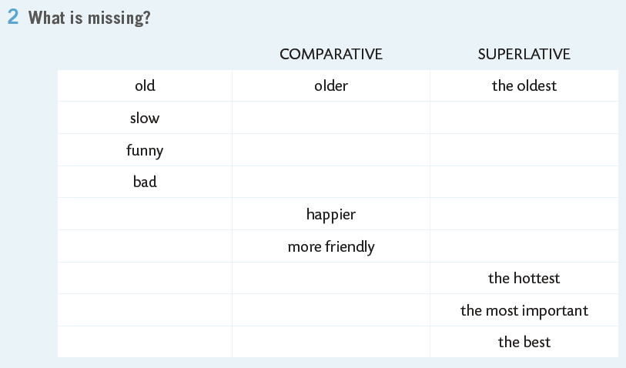
What is missing?
slower
the slowest
friendly
the most friendly

Slide 8
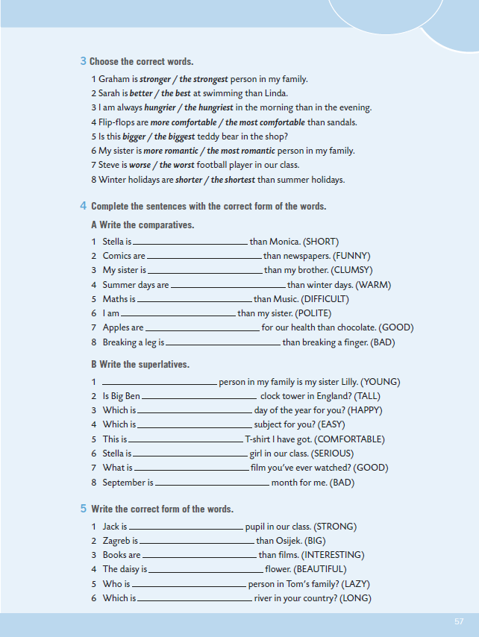
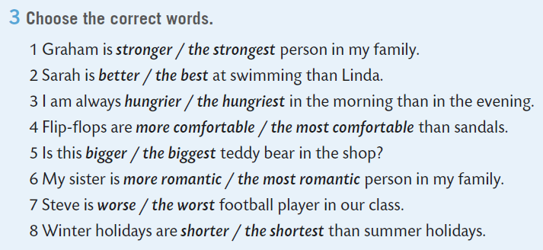
Choose the correct words.

Slide 9
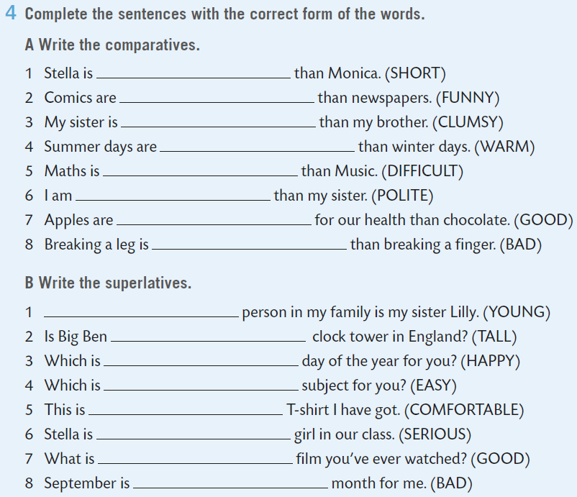
Complete the sentences with the correct form of the words.
shorter
The youngest

Slide 10
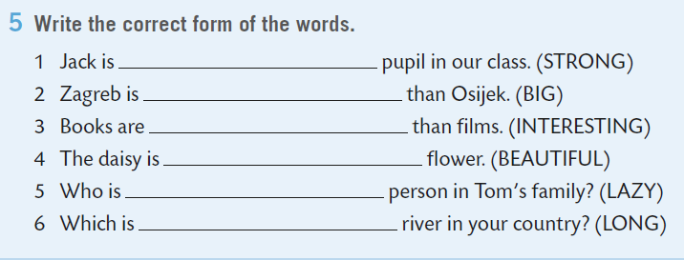
Write the correct form of the words.
the strongest
bigger
Practice here: https://www.e-sfera.hr/dodatni-digitalni-sadrzaji/09ab29d4-07dc-4f20-a706-763426686e76/assets/interactivity/kviz_3/index.html

Slide 11
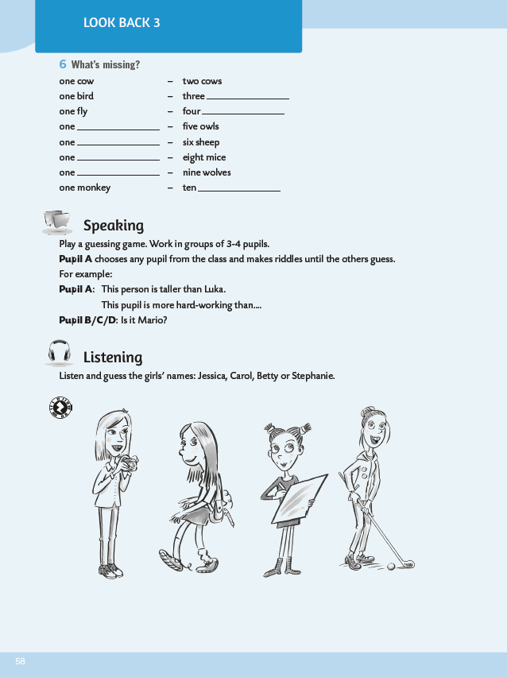
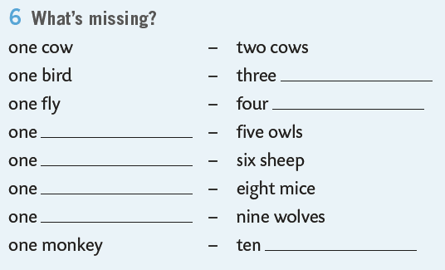
What’s missing? .
birds
owl

Slide 12
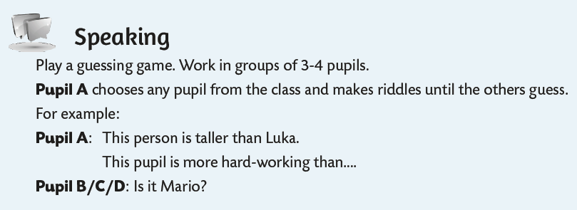
Call one of your clasamates and play a guessing game.

Slide 13
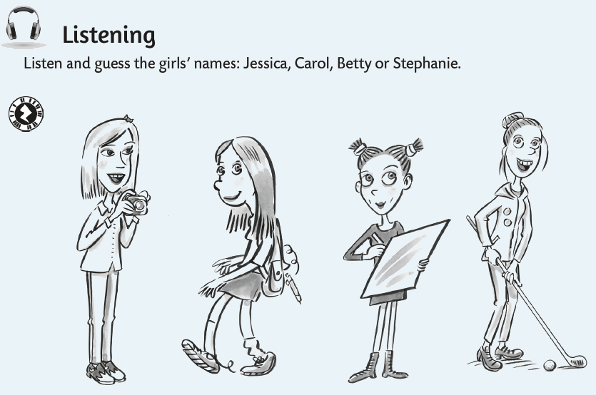
In the listening section, listen and guess the girls’ names. https://www.e-sfera.hr/dodatni-digitalni-sadrzaji/09ab29d4-07dc-4f20-a706-763426686e76/assets/audio/look_back_3a-_guess_the_names.mp3
Carol
Stephanie
Betty
Jessica

Slide 14
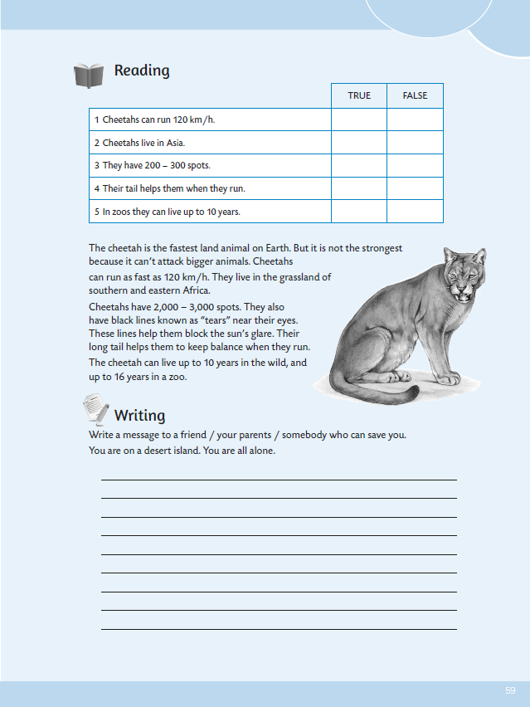
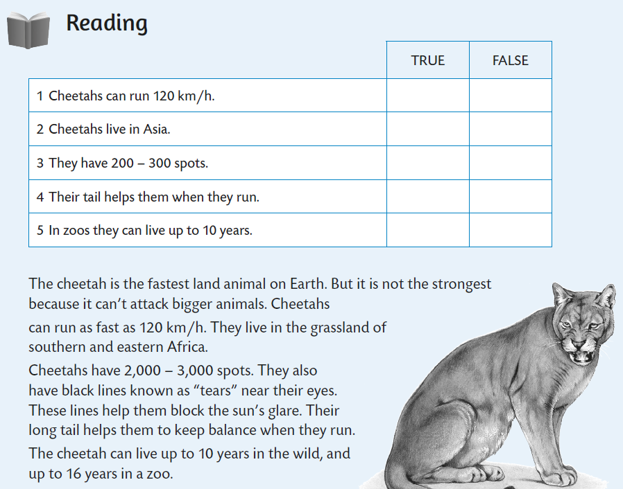

Read the text and do the task: true or false?

Slide 15
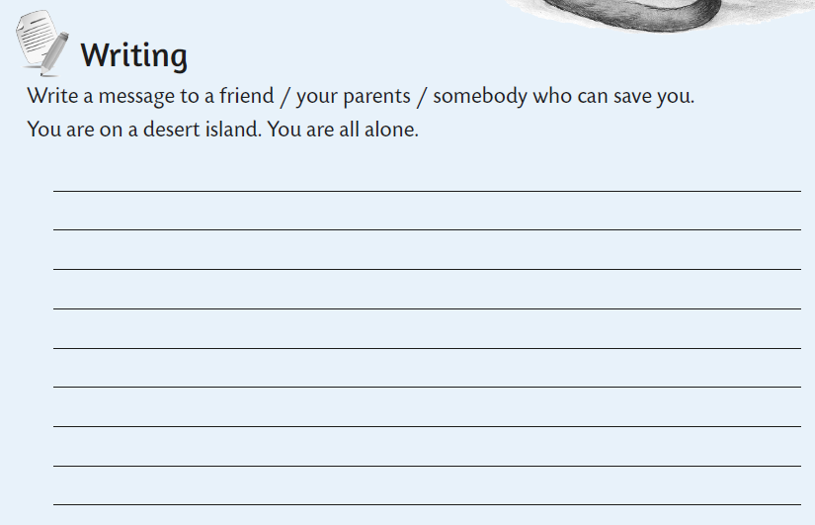
Write a message to a friend / your parents / somebody who can save you. You are on a desert island. You are all alone. Napiši poruku svom prijatelju/roditeljima/nekome tko te može spasiti. Nalaziš se na pustom otoku i potpuno si sam.

Slide 16
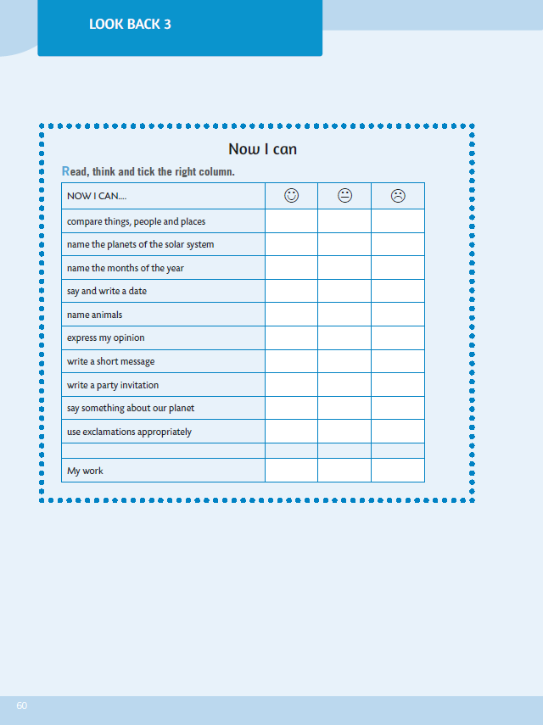
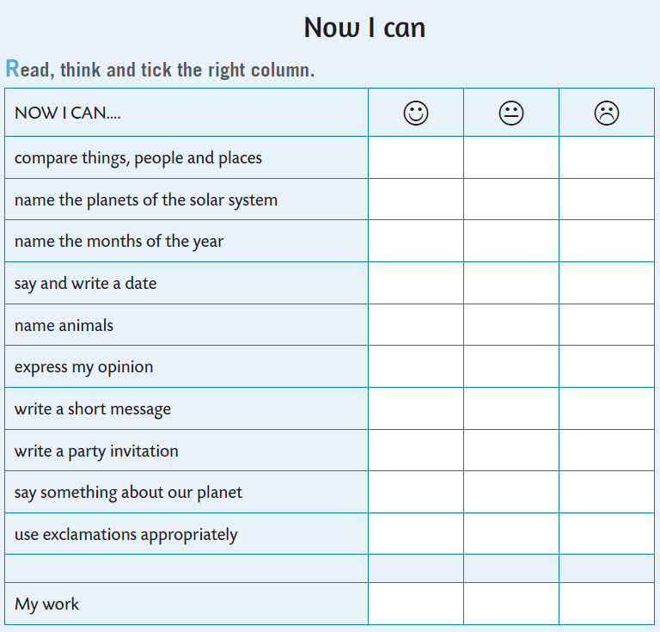



Now you can self-evaluate. Read the sentences, think and tick the right column.
- usporediti stvari, ljude i mjesta
- imenovati planete Sunčevog sustava
- imenovati mjesece u godini
- izreći i napisati datume
- imenovati životinje
- izreći svoje mišljenje
- napisati kratku poruku
- napisati pozivnicu za zabavu
- reći nešto o svom planetu
- koristiti ispravno usklike

